Slide 1
CARD PAYMENT

Slide 2

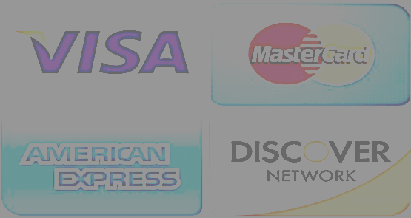
Four Party Model
Card Holder
(consumer)
Merchant
(accepts the card)
1. Payment Initiation
It exchanges payment data between merchant, acquirer, issuer etc
6.Transaction
Notification
Network
2. Auth Request
5. Auth Request
3. Auth Request
3. Auth Request
Issuer
(cardholder’s bank)
4. Auth Request
Acquirer
(merchant’s bank)
4. Auth Request
Financial institution that issues credit/debit cards to consumers responsible for approving/declining transactions based on cardholder’ status, etc.
Financial institution that partners with merchant to process the transactions and connecting with network etc

Slide 3
Four Party Model and other parties
Card Holder
(consumer)
Merchant
(accepts the card)
ISO
Card Personalization
Network
Acquirer Processor
Issuing Processor
Payment Gateway
Card Management
Payment Facilitator
Issuer
(cardholder’s bank)
Acquirer
(merchant’s bank)

Slide 4






Payment Ecosystem
Traditionally merchants could only connect to Payment Networks, such as Visa directly, through an acquirer, but these days, to meet the diverse range of merchant needs there are other entities who play important roles between – or on behalf of – the acquirer and merchant, that have become increasingly integral to the acceptance ecosystem.
Payment Service Providers (PSP)
(also called Merchant Service Providers) are third parties that help merchants accept payments by providing value added services and connectivity to payment networks.
Third party bill payment providers,
not all merchants accept electronic payments (for instance public utilities or commercial billers), however, customers still want to pay with their payment card and third parties who have a pre-existing relationship between the customer and merchant can step in.
Independent Sales Organizations
(ISOs), work with acquirers to conduct multiple activities, including seller account or transaction processing solicitation, sales, customer service, seller training activities or solicitation and sales of POS terminals, Mpos devices or other acquirer acceptance solutions.
Payment facilitators (or Payfacs) act as a “master merchant” who can both sign a merchant acceptance agreement with a seller on behalf of an acquirer, and receive settlement funds proceeds from an acquirer, on behalf of the underlying merchant (known as a “sub-merchant”).
Acquirer processors, are appointed by a merchant to handle transactions from various channels for the acquiring bank.
Digital wallet operators are softwarebased systems that store a customer’s payment card details to fund a wallet account and are used to make payments.

Slide 5
Acquiring Bank vs Payment Processor
Understanding the difference between an acquiring bank and a payment processor provides valuable insight into how your transactions are processed.
Acquiring Bank
Payment Processor
Financial Institution
Holds the merchant’s account where funds are initially deposited
Receives transaction details from the payment processor
Interacts directly with the card networks (Visa,
MasterCard, etc.) to forward transaction details
Handles risk assessment and underwriting for the merchant
Provides the Merchant ID (MID) which identifies each
merchant for transactions
Works primarily behind the scenes and has no direct interaction with the customer
Compliance with banking regulations and card network rules
Technology service provider
Does not hold merchant accounts but communicates
transaction details to the acquiring bank
Encrypts and sends transaction details to the acquiring bank
Does not interact directly with card networks
Provides fraud detection and prevention mechanisms
Provides the Payment Gateway for the merchant to receive
online card payments
May interact with customers during the transaction process
(e.g., entering card details, handling error messages, etc.)
Ensures transactions comply with PCI DSS standards for
data security
While the acquiring bank and the payment processor play significant roles in facilitating card transactions, their duties
and areas of expertise are distinct. The acquiring bank operates mainly in the financial and regulatory domain, while
the payment processor handles the technological and customer-facing aspects of the transaction process.

Slide 6
Bank Owned Payment Processor and Third-Party Payment Processor
Bank-Owned Payment Processing:
The payment processing system is owned and controlled by the bank
The bank manages the payment processing infrastructure, security, and customer service
Usually offered as part of a suite of banking services
May have higher fees and less flexible pricing compared to third-party payment processing
Third Party Payment Processing:
The system is owned and controlled by a third-party provider
Typically offers more customization and flexibility compared to bank-owned payment processing.
Provides access to a larger network of merchants and B2B partner programs
Advantages
Advantages
Established Relationship
Known Reputation
Increased Control
Customization
Integration Capabilities
Technical Expertise
Scalability
Innovation
Disadvantages
Disadvantages
Limited Customization Options
Dependent on Bank’s Performance
Reduced Control
Lack of In-House Support
Security Concern

Slide 7
Best choice between Acquirer Processor or Third Party Processor
When to choose Acquirer Processor?
When you need to set up your business by creating own merchant account
When your sales volume and average transaction size is higher
When you need control over the payments
Acquirer processor charges setup fee, monthly fee, early termination fee ,transaction fee, annual fee. The transaction fee is less comparison to the third party processor. So, the Acquirer processor is well suitable for Enterprise merchants
When to choose Third Party Processor?
When you do not need to worry about creating the merchant account. Third party processor will create master merchant account by accumulating all of their clients' transactions into a single merchant account
When your sales volume and average transaction size is low
When you don’t need control over the payments
Unlike merchant accounts with banks that tend to be expensive and time-consuming to set up,
third-party payment processors don’t charge a huge deposit fee for setup. You’re only charged for the transactions you make and per-transaction fee is higher than the acquirer processor. So, the third party processor is suitable for medium-level and small-medium enterprise merchants

Slide 8
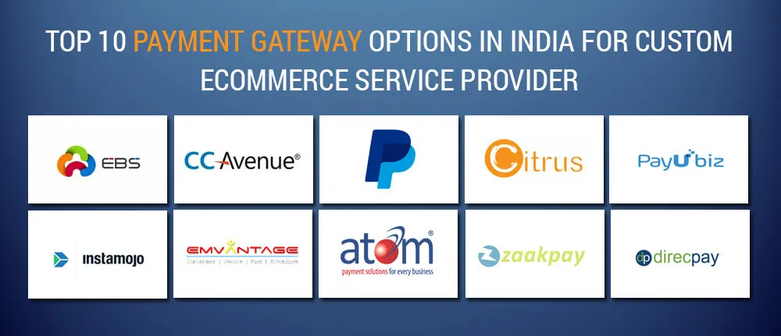
Payment Gateway
A payment gateway is an infrastructure company that provides software on a SaaS (Software as a Service) distribution model. To put it simply, the gateway is a bridge between the client and the merchant. Its role is to transfer data between the major players involved in transaction processing: the customer, the merchant, the acquiring bank, the issuing bank, and the card network.
How Payment Gateways make money
Payment Gateway earns income from each transaction by taking a percentage and/or fixed fee that
is called Merchant Discount Rate (MDR). Detailed Information in Slide 12.
Payment Gateway Business Model
Payment gateways generate most of their revenue from MDR, but the amount of charge varies
depending on the mode of transaction. During the payment phase, the client chooses the preferred
way to pay for the purchase. Depending on whether the client chooses a credit card or a debit card,
an e-wallet, Internet banking, or a prepaid wallet, the MDR charge will differ.

Slide 9
Payment Facilitator or PayFacs
A Payfac will sign up for a master merchant account with an acquirer and sign-up individual merchants(micro, small and medium sized enterprises) as sub-merchants who fall under the Payfac’s master merchant relationship with the acquirer for transaction clearing and settlement with the Payfac underwriting their sub-merchants’ sales on behalf of the acquirer.
Example : Freecharge, Paytm, PayU, PhonePe, RazorPay , Instamojo
How do Payment Facilitators Work?
The payment facilitator owns the master merchant identification account (MID). To process transactions, the acquirer (merchant) must apply for a merchant account. This includes an application with 7-8 key data points, an underwriting process, working out a pricing agreement, and integrating the latest payment technology.
During the onboarding process, the data points are evaluated by an underwriting tool and approved or declined in real-time. Then, payment gateway is opened and the merchant is boarded as a sub-merchant under the PayFac‘s master merchant ID.
Traditional Acquirer
Payment Facilitator
A merchant contracts with an acquirer to accept and process payments.
The merchant uses a merchant bank account to accept payment types like credit, debit, and other forms.
The acquirer issues each merchant their own account.
The acquirer directs funds from the buyer to the merchant account.
A PayFac contracts with an acquirer to accept payments on behalf of their sub-merchants.
PayFac uses a master merchant account to accept all payments for the sub-merchant.
The acquirer issues the PayFac a master merchant account.
The PayFac directs the funds from the buyer to the sub-merchant account.

Slide 10
Other Participants
Cardholder
(consumer)
It refers to the process of customizing a payment card with the cardholder’s specific info like printing cardholder’s name, card number, expiration date and CVV, etc
Card Personalization
It is responsible for managing the technical processing of card transactions by verifying the card details and the cardholder’s account status on behalf of card issuer
Issuing
Processor
It is responsible for managing the technical processing of card transactions by verifying the card details and the cardholder’s account status on behalf of card issuer
Card Management
Issuer
(cardholder’s bank)

Slide 11
Calculating Transaction Discount Rate
On average, the merchant is charged 1-3% of MDR (Merchant Discount Rate) for each
transaction processing. MDR is a general amount of fees that a merchant pays for the
transaction processing. Assuming that the whole amount of MDR a merchant should
pay is 1.0%, it will split into:
0.35% fee to the card network;
0.35% fee to the acquiring bank.
0.20% fee to the payment gateway service provider;
0.10% fee to the payment orchestration platform;
For instance, a customer makes a $1,000 purchase at the online store by Visa credit
card. From this amount, the merchant will pay $3.50 to the card network, $2 to the payment gateway, $1 to the payment orchestration platform (includes ISVs, Payment Processor, PayFacs, POS Providers etc), and $3.50 to the acquiring bank. Thus, a merchant would receive 990$ out of 1000$ paid by the customer.

Slide 12
Other Entities
Independent Software Vendors(ISVs)
These are the companies that develops and sell software that can
integrate with various payment system and platforms
POS Providers:
Point-of-Sale providers are the companies that offer hardware and software
necessary for processing transactions at retail locations.
Value Added Resellers (VARs):
Company that resells software, hardware and other products and services
that customize third-party products in an effort to add value and resell them with
additional offerings bundled in.
POS Providers
Value Added Resellers (VARs)

Slide 13




Independent Software Vendors (ISVs)
ISVs, or Independent Software Vendors, are businesses that develop and distribute
software products to end-users. They operate independently of hardware manufacturers
or platform providers, but collaborations with these entities are feasible.
How ISVs generates revenue?
ISVs generate revenue through software licensing via subscription or one-time purchase.
That means either through upfront payments or recurring maintenance contracts.
As an example, Intuit software operates on a subscription-based model, which users pay for on a monthly or annual basis. While Autodesk allows subscriptions and one-time purchases for permanent software access.

Slide 14




POS Providers
A POS system, or point-of-sale system, is a combination of hardware, software and payment services that businesses use to make sales. And as its name implies, this system exists at the physical or virtual point of sale. Online-only businesses, however, do not require hardware to complete their POS systems.
Business model of POS devices:
There are several types of POS devices that merchants can use to accept electronic payments. These devices range from basic countertop terminals to more advanced mobile and wireless solutions. The company charges a transaction fee for each payment processed through its POS devices. The fee is typically a percentage of the transaction value, ranging from 0.5% to 2%, depending on the payment type and the merchant’s pricing plan. Some POS providers also charges a fixed monthly rental fee for its POS devices.

Slide 15
Value Added Resellers
A Value-Added Reseller (VAR) is a business or entity that acts as a middleman between a manufacturer and end customers. The VAR buys products from the manufacturer and then resells them to its customers, adding value by offering additional services, support, and customization.
Example: AVI-SPL, Servers Direct, CDW, Globenet Internation
Business Model of VARs
Resell Your Product/Service :
VARs purchase products or services from manufacturers or distributors and resell them to their customers
Add Value to Your Product/Service
VARs add value to the products or professional services they resell through various means, such as customization, integration, software installation services, training, or support.
Maintain Their Own Profitability
VARs must balance the cost of acquiring products and services with the price they charge customers and find ways to increase revenue and profits through value addition and other means.
Provide Customer Service & Support
VARs are responsible for providing ongoing support and customer service to their customers. This helps them build their own customer loyalty and drive repeat business through excellent customer experiences.

Slide 16

Payment Process overview
This presentation provides an overview of the payment process, including the transaction life cycle, revenue sharing, and transaction types.
Understanding these elements is crucial for navigating the payment landscape.

Slide 17
Transaction Life Cycle
Authorization
The bank approves or declines a card transaction.
Timing
This process happens instantly.
Settlement
Money moves from the cardholder's bank to the merchant's bank.
Timing
Usually done at the end of the day.

Slide 18
Revenue Sharing (Actual Rates May Vary)
Card Holder
Merchant
$100
$98
Issuer
Network
Processor
Acquirer
$1.40
$0.10
$0.05
$0.45
Acquirer distributes to other channel partners (ISO, ISV, Gateway etc) including processors.

Slide 19
Transaction Type : Card Present (Offline)
Magstripe (Swipe)
Chip (Dip)
Contactless (Tap)
NFC (Near Field Communication)
QR Code

Slide 20
Transaction Type : Card Present (Offline)
Magstripe (Swipe)
Chip (Dip)
Advantages:
Ubiquity: Widely available and supported by most card readers.
Ease of Use: Simple to use by swiping the card through a reader.
Speed: Generally quick transaction processing.
Disadvantages:
Security: Less secure than chip-based methods; magnetic stripes can be easily cloned.
Wear and Tear: Magnetic stripes can get demagnetized or worn out over time.
Fraud: Higher risk of skimming and data theft.
Usage:
Once the most common method, its usage has declined with the rise of chip cards due to security concerns.
Advantages:
Security: More secure than magnetic stripes due to EMV (Europay, MasterCard, and Visa) technology, which uses encrypted data.
Fraud Prevention: Difficult to clone, reducing the risk of card-present fraud.
Global Standard: Widely accepted and becoming the standard in many countries.
Disadvantages:
Speed: Slightly slower than swipe transactions due to the time taken to read the chip.
Compatibility: Not all older terminals can read chip cards.
Usage:
Rapidly becoming the standard method globally, especially in Europe and North America.

Slide 21
Transaction Type : Card Present (Offline)
QR Code
Contactless (Tap)
QR Code
Advantages:
Accessibility: Can be used by anyone with a smartphone, even without NFC.
Cost-effective: Merchants can use it without needing special hardware.
Security: Can be quite secure when implemented correctly.
Disadvantages:
Speed: Generally slower than NFC and contactless methods due to scanning and manual input.
User Experience: Can be less seamless than other methods, as it requires scanning.
Usage:
Widely used in regions like Asia, particularly China, where QR code payments via platforms like Alipay and WeChat Pay are dominant.
Advantages:
Convenience: Quick and easy transactions by simply tapping the card.
Speed: Faster than both swipe and dip methods.
Hygiene: No physical contact with the reader, beneficial in contexts like pandemics.
Disadvantages:
Limitations: Often has a transaction limit for contactless payments, requiring PIN entry for larger amounts.
Security Concerns: Though generally secure, there is a minor risk of unauthorized transactions if the card is lost.
Usage:
Increasingly popular worldwide, especially in urban areas and for small transactions.

Slide 22
Transaction Type : Card Present (Offline)
NFC (Near Field Communication)
Advantages:
Convenience: Allows mobile payments with smartphones, eliminating the need for carrying physical cards.
Security: Uses tokenization, making transactions very secure.
Speed: Very quick, similar to contactless card payments.
Versatility: Can integrate with loyalty programs, tickets, etc.
Disadvantages:
Dependency on Battery: Requires a charged smartphone.
Device Compatibility: Not all smartphones and terminals support NFC.
Adoption: Requires merchants to have NFC-capable terminals.
Usage:
Growing rapidly, especially in tech-savvy regions and among younger consumers. Services like Apple Pay, Google Pay, and Samsung Pay are driving adoption.

Slide 23
Transaction Type : Card Not Present (Online)
Mobile & Telephone Orders
3DS Secure Transaction
E-Commerce Transaction
EMI , Installments, Recurring Transactions (Subscription)
QR Code

Slide 24
Transaction Type : Card Not Present (Online)
Mobile & Telephone Orders
E-Commerce Transaction
Advantages:
Accessibility: Convenient for consumers without internet access.
Flexibility: Can be used for placing orders on-the-go.
Direct Communication: Enables interaction with customer service representatives.
Disadvantages:
Security: Sensitive information shared over the phone can be intercepted.
Human Error: Potential for mistakes in information recording.
Verification Issues: Difficulty in verifying the cardholder’s identity.
Usage:
Common for ordering goods and services that require direct interaction.
Advantages:
Convenience: Enables shopping from anywhere at any time.
Variety: Access to a wide range of products and services.
Price Comparison: Easy to compare prices across different vendors.
Disadvantages:
Security: Risk of fraud and data breaches.
Shipping Delays: Possible delays in receiving purchased items.
Return Policies: Variability in return policies can be inconvenient.
Usage:
Dominates the retail sector with continuous growth.

Slide 25
Transaction Type : Card Not Present (Online)
EMI, Installments, Recurring Transactions (Subscription)
EMI, Installments, Recurring Transactions
Advantages:
Affordability: Spreads the cost over time, making high-value purchases more manageable.
Convenience: Automatic payments for subscriptions ensure continuous service.
Customer Retention: Encourages long-term customer relationships.
Disadvantages:
Debt Risk: Can lead to debt accumulation if not managed properly.
Complexity: Managing multiple installment plans can be cumbersome.
Cancellation Issues: Cancelling subscriptions or installment plans can be difficult.
Usage:
Popular for big-ticket items, subscriptions, and services requiring regular payments.
Advantages:
Security: Adds an additional layer of security with two-factor authentication.
Fraud Prevention: Reduces the risk of unauthorized transactions.
Consumer Confidence: Increases trust in online transactions.
Disadvantages:
User Experience: Additional steps can slow down the checkout process.
Technical Issues: Potential for issues with authentication process.
Adoption Rates: Not all merchants support 3DS, leading to inconsistent experiences.
Usage:
Increasingly adopted for high-value transactions and by security-conscious merchants.

Slide 26
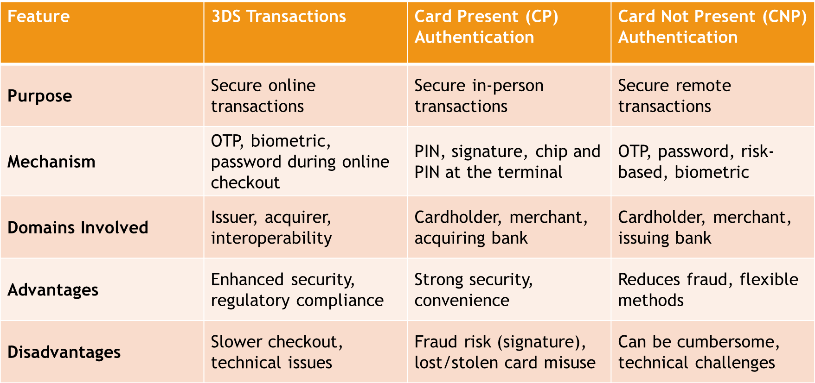
3DS VS CP (Card Present) VS CNP (Card Not Present )

Slide 27
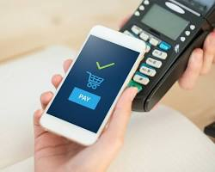
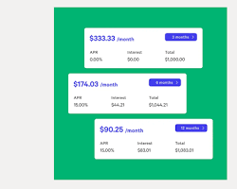

Fastest Growing Payment Methods & Future Projections
Digital Wallets (NFC & Online)
Buy Now Pay Later (BNPL)
Recurring Transactions
Advantages:
Affordability: Spreads the cost over time, making high-value purchases more manageable.
Convenience: Automatic payments for subscriptions ensure continuous service.
Customer Retention: Encourages long-term customer relationships.
Disadvantages:
Debt Risk: Can lead to debt accumulation if not managed properly.
Complexity: Managing multiple installment plans can be cumbersome.
Cancellation Issues: Cancelling subscriptions or installment plans can be difficult.
Usage:
Popular for big-ticket items, subscriptions, and services requiring regular payments.

Slide 28
High Usage In E-Commerce
Digital Wallets, CNP, BNPL
In USA TikTok E-Commerce
Digital Wallets (NFC and Online)
  Examples: PayPal, Apple Pay, Google Pay.
BNPL Services
  Examples: Afterpay, Klarna, Affirm.
Why These Methods?
Digital Wallets: TikTok’s predominantly younger user base prefers the convenience and speed of digital wallets.
BNPL Services: Attractive to younger consumers who favour flexible payment options, which aligns with TikTok’s demographic.
Digital Wallets (NFC and Online)
  Examples: PayPal, Apple Pay, Google Pay.
BNPL Services
  Examples: Afterpay, Klarna, Affirm.
Why These Methods?
Digital Wallets: TikTok’s predominantly younger user base prefers the convenience and speed of digital wallets.
BNPL Services: Attractive to younger consumers who favour flexible payment options, which aligns with TikTok’s demographic.

Slide 29
Payments Conclusion
Fastest Growing Methods:
Digital Wallets (NFC and Online)
BNPL Services
Recurring Transactions (Subscriptions)
Most Used in Future:
Digital Wallets
Recurring Transactions (Subscriptions)
High Usage in E-commerce:
Digital Wallets
Card Not Present Transactions
BNPL Services
Most Used for TikTok E-commerce in the USA:
Digital Wallets
BNPL Services
The integration of Digital Wallets and BNPL services into e-commerce platforms is revolutionizing online shopping, making transactions quicker, more secure, and flexible, catering to the needs of modern consumers. This trend is especially prevalent in platforms like TikTok, where the younger demographic is driving the adoption of these payment methods.

Slide 30
Introduction to Fraud
Definition of Fraud:
Fraud in the payment process refers to deceptive practices aimed at unlawfully obtaining funds or financial benefits through the payment systems used for transactions. It can occur at various stages of a payment process and can involve different methods.
There are mainly 2 types:
Disputed or Non Fraud Related Dispute
Fraudulent Transaction

Slide 31
Disputed or Non-Fraud Related Disputes
Disputed or non-fraud related disputes refer to issues with transactions that arise from errors or misunderstandings rather than fraudulent activities. These disputes typically involve situations where the transaction was authorized by the cardholder but there were problems with the transaction or the service provided.
Examples:
Amount Deducted Twice
The cardholder was charged twice for the same transaction
Amount Deducted but Service Not Rendered
  The cardholder was charged for a service or product that was not delivered or provided.
Bought by Mistake
  The cardholder accidentally made a purchase and wants to reverse the transaction.
Wrong Amount Deducted
  The cardholder was charged an incorrect amount, either more or less than what was agreed upon.
In these cases, the dispute is generally resolved by contacting the merchant or the card issuer to investigate and correct the error. These disputes do not involve fraudulent activities where someone intentionally tries to deceive the cardholder or the financial institution.

Slide 32
Fraudulent Transaction
A fraudulent transaction is a financial operation conducted without the knowledge or consent of the account holder, with the intent to deceive or defraud. These transactions can involve the unauthorized use of a person's credit/debit card, bank account, or other financial assets to make purchases, withdraw money, or transfer funds.
Examples:
Phishing
Deceptive attempts to acquire sensitive information by masquerading as a trustworthy entity
Skimming
Using devices to steal card information during legitimate transactions.
Hacking
Unauthorized access to financial accounts or systems.
Identity Theft
Using someone else's personal information to open accounts or make transactions.
Card-Not-Present Fraud
Transactions made without the physical card, often online or over the phone.
Fraudulent transactions can cause significant financial loss and inconvenience to the victims and require stringent security measures and monitoring by financial institutions to prevent and detect them.

Slide 33
FIRST PARTY FRAUD
First party fraud occurs when the legitimate account holder or cardholder intentionally uses their own account or card to commit fraud. This type of fraud involves deceitful actions by the person who owns the account or card, often to gain financial benefit or to avoid financial responsibility.
Examples:
Synthetic Identity Fraud
  Creating a fake identity by combining real and fictitious information (e.g., using a real social security number with a fake name) to open accounts or make purchases.
Application Fraud
  Providing false information on a loan or credit card application to obtain funds or credit that the applicant is not eligible for.
NRI (Non-Resident Indian) Fraud
  Specifically relevant in regions with significant NRI populations, where the cardholder might misuse their accounts or cards knowing that cross-border legal enforcement can be challenging.
Chargeback Fraud (or Friendly Fraud)
  Making a purchase with their own card and then disputing the charge, falsely claiming that the transaction was unauthorized or that they did not receive the goods or services.
First party fraud can be particularly challenging to detect and prevent because it involves the genuine account holder, who has legitimate access to the account or card and may provide plausible explanations for their actions.

Slide 34
Third Party Fraud
Third Party Fraud involves someone other than the legitimate account holder or cardholder using their account or card to commit fraud. This type of fraud is usually conducted without the cardholder's knowledge or consent.
Examples:
Lost or Stolen Card Fraud
Someone finds or steals a physical card and uses it to make unauthorized purchases.
Account Takeover
  A fraudster gains access to the account holder's account, often through phishing, hacking, or social engineering, and then uses it to make unauthorized transactions.
Counterfeiting
  Creating fake cards using the account details of legitimate cardholders to conduct fraudulent transactions.
Social Hacks
  Using social engineering techniques to trick the cardholder or bank employees into revealing account details, which are then used to commit fraud.

Slide 35
Third Party Fraud
Merchant Fraud
Merchants manipulating transactions to defraud the cardholder or the issuing bank, such as charging for goods or services that were not provided.
Phishing and Vishing
  Fraudsters sending emails (phishing) or making phone calls (vishing) posing as legitimate entities to trick individuals into revealing sensitive information like card numbers, passwords, or other personal details.
Skimming
  Using devices to capture card information from ATMs or point-of-sale terminals when the card is used.
Third-party fraud is typically more challenging for the cardholder to prevent, as it often involves external parties exploiting vulnerabilities in security systems or using sophisticated techniques to gain unauthorized access.

Slide 36
Dispute Transaction Flow
The dispute transaction flow outlines the process followed when a cardholder disputes a transaction. This process ensures that disputes are investigated and resolved appropriately.
Merchant Provides Documentation
The cardholder notices an issue with a transaction (e.g., an incorrect charge) and reports it to the issuer (the bank or financial institution that issued the card).
Issuer Sends Transactions to the Network
The issuer forwards the disputed transaction details to the payment network (e.g., Visa, MasterCard), which then sends these details to the acquirer (the bank or financial institution that processes card payments on behalf of the merchant).
Acquirer Receives and Processes the Dispute
  The acquirer receives the dispute information and can either accept the chargeback and be charged for the transaction or forward it to the merchant for further action.
Merchant Reviews the Chargeback
The merchant reviews the chargeback details and decides whether to accept the chargeback (acknowledging the dispute and the related charge) or to challenge it.

Slide 37
Dispute Transaction Flow
Cardholder Reports Disputed Transaction
If the merchant does not accept the chargeback, they provide documentation to the acquirer to represent the chargeback to the issuer, supporting their case that the transaction was valid.
Acquirer Examines Documentation
The acquirer examines the provided documentation to ensure it meets the card network rules and supports the merchant’s claim.
Issuer Reviews the Documentation
  The acquirer sends the documentation back to the issuer. If the issuer accepts the documentation and believes the transaction was valid, they represent the transaction to the cardholder.
Resolution
If the issuer accepts the documentation, the merchant gets the money back, and the issuer re-charges the cardholder. If either party (issuer or merchant) disagrees with the final outcome, the payment network reviews the documentation and the transaction to make the final decision
This process ensures that both cardholders and merchants have a fair chance to present their cases and resolve disputes according to established rules and guidelines.

Slide 38
Fraud Transaction Flow
Similar to disputes, the main difference is on the liability of Fraud
The Liability of Fraud $) - Who Bears the loss?
Between Issuer & the merchant whoever was on the less secure technology will bear the cost of fraud (generally), if both were on the same technology level then Issuer will bear the fraud
Chip Transaction -> Card was Chip, Terminal Used a Chip Technology, Card was dipped & not swiped -> Issuer is liable.
If Card was Chip enabled but merchant didn’t dip rather swiped the transaction (used the magstripe) then merchant will be liable for fraud.
For eCom transactions if merchant didn’t use authentication then typically merchant is liable for fraud.
Example:

Slide 39
TOKENIZATION
WHAT IS A TOKENIZATION:
Tokenization is the process of replacing sensitive data with non-sensitive placeholders called tokens.
Token is a unique identifier that substitutes sensitive information, such as a credit card number or personal account number. The token itself is a string of characters that has no inherent value.

Slide 40
Key Characteristics of a Token
The key characteristics of a token as follows
Randomly Generated
Tokens are usually generated in a random or pseudo-random manner, ensuring they don't follow a predictable pattern.
Non-reversible
A token cannot be converted back into the original data without access to the secure "token vault" where the mapping between the token and the original data is stored.
Unique
  Each token is typically unique to a specific transaction or a specific piece of sensitive data, reducing the risk of misuse
Usage Limitation
Tokens are often limited in scope, meaning they can only be used in the context for which they were generated (e.g., for a single transaction or with a specific merchant).

Slide 41
ADVANTAGES AND DISADVANTAGES OF TOKENIZATION
ADVANTAGES
ENHANCED SECURITY
Tokenization reduces the risk of sensitive data exposure because tokens are meaningless to unauthorized users and can only mapped back to the original data by the tokenization system.
REDUCED PCI DSS SCOPE
By replacing sensitive data with tokens, organizations can minimize the scope of PCI DSS (Payment Card Industry Data Security Standard) compliance audits and requirements.
FRAUD PREVENTION
Tokens are useless if intercepted during transactions or stored improperly, reducing the incentive for cybercriminals to target such data.
FACILITATES MOBILE PAYMENTS
Tokens can be used for secure mobile payments, enabling devices like smartphones to make payments without storing actual card details.
EASE OF INTEGRATION
Tokenization Systems are designed to integrate with existing payment infrastructures relatively seamlessly, minimizing

Slide 42
ADVANTAGES AND DISADVANTAGES OF TOKENIZATION
DISADVANTAGES
IMPLEMENTATION COMPLEXITY
Implementing tokenization systems can be complex and require significant initial setup and integration efforts.
DEPENDANCY ON TOKENIZATION PROVIDERS
Organizations using tokenization rely heavily on their tokenization service providers for security and system reliability.
COST
There are costs associated with implementing and maintaining tokenization systems, including fees for tokenization services and potential upgrades to existing systems
TOKEN MANAGEMENT
Managing the lifecycle of tokens, including creation, mapping, and eventual deactivation, require careful management and oversight.
COMPATIBILITY ISSUES
Ensuring compatibility across different payment systems, processors, and platforms can sometimes be a challenge, especially in complex environment.

Slide 43
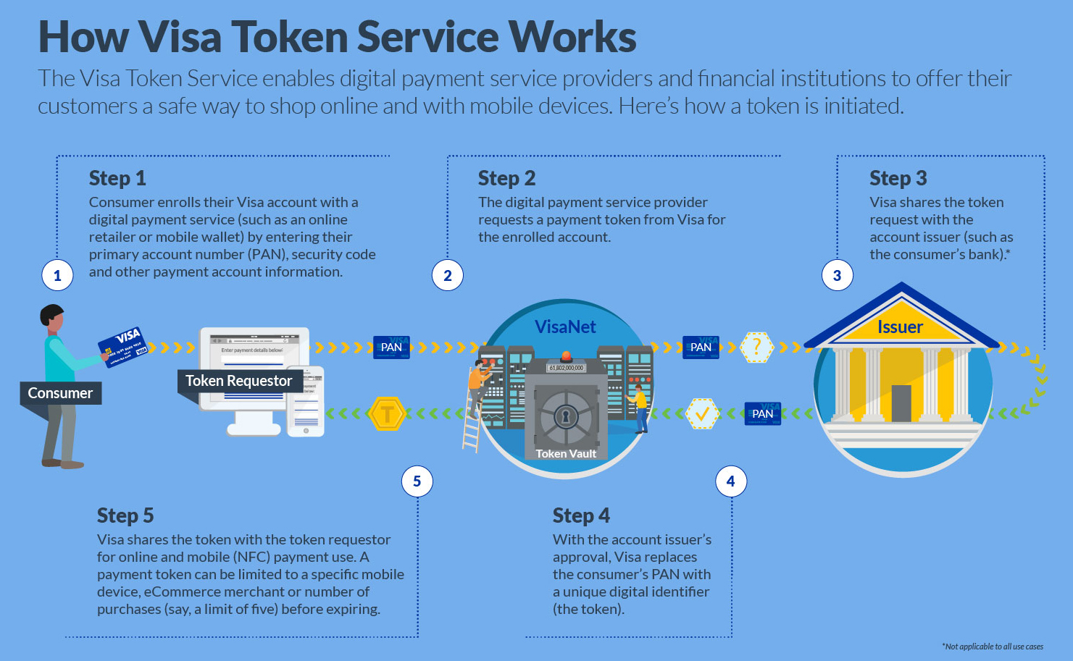
How Visa Token Service works
The Visa Token Service (VTS) provides a secure way for consumers to make online and mobile payments by replacing sensitive payment information with a unique digital identifier, known as a token. Here's how the Visa Token Service works.

Slide 44
How Visa Token Service works
Enrollment
Consumer Action: The consumer enrolls their Visa account with a digital payment service, such as an online retailer or mobile wallet. During this process, they enter their Primary Account Number (PAN), along with other payment information like the security code.
Token Request
Token Requestor: The digital payment service provider, acting as a token requestor, requests a payment token from Visa for the enrolled account. This is done by sending the PAN and other relevant information to Visa.
Issuer Verification
Visa & Issuer: Visa receives the token request and shares it with the account issuer, which is typically the consumer’s bank. The issuer reviews the request and decides whether to approve or deny it.
Token Generation
Token Vault: If the issuer approves the request, Visa replaces the consumer’s PAN with a unique digital identifier, called a token. This token is generated and securely stored in the Visa Token Vault.

Slide 45
How Visa Token Service works
Token Use
Payment Use: Visa shares the token with the token requestor, enabling it to be used for future online and mobile (NFC) payments. The token can be limited to specific conditions, such as being valid only for a particular mobile device, eCommerce merchant, or a limited number of transactions (e.g., five purchases) before it expires.
This process ensures that the consumer's actual payment information is not exposed during transactions, significantly enhancing security. Even if a token is intercepted, it cannot be used outside the specific context for which it was issued.

Slide 46
TOKEN BENEFITS
Reduces Fraud & Breach Risk:
By replacing card numbers with a digital token, the risk of fraud and data breaches is significantly reduced.
Instant Replacement of Credentials:
Issuers can instantly replace stolen credentials or expired cards, and tokens can be updated automatically without requiring the consumer to take action.
Improved Transaction Security:
Each transaction is processed with both a token and cryptogram validation, which increases card authorization rates and decreases fraud.
Enhanced Consumer Experience:
Tokens contribute to an enhanced consumer experience and easier payments, making digital transactions more secure and convenient.

Slide 47
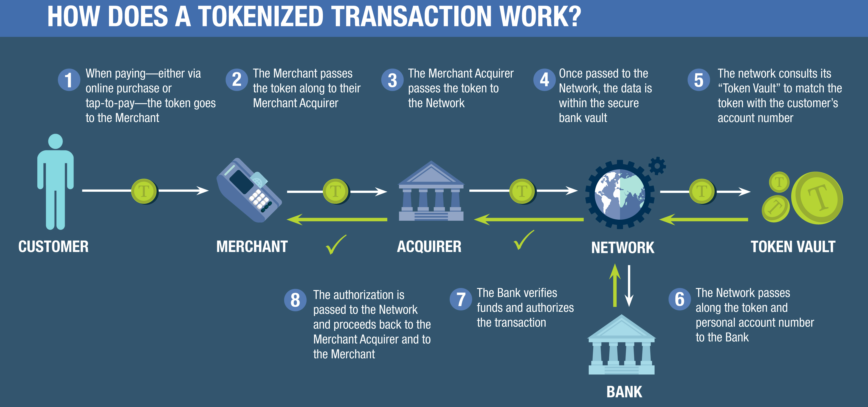
How Does A Tokenized Transaction Work

Slide 48
How Does A Tokenized Transaction Work
Customer Payment
When a customer makes a payment, either online or via tap-to-pay, a token is generated and sent to the merchant. This token represents the customer's payment information without exposing their actual account details.
Merchant's Role
The merchant receives the token and passes it along to their Merchant Acquirer, which is typically a bank or financial institution that processes credit and debit card payments on behalf of the merchant.
Merchant Acquirer
The Merchant Acquirer forwards the token to the payment network, such as Visa, MasterCard, or another card network.
Network and Security
Once the payment network receives the token, the data is securely transmitted and stored within a secure bank vault, known as the Token Vault.

Slide 49
How Does A Tokenized Transaction Work
Token Vault
The payment network consults the Token Vault, where the token is matched with the customer’s actual account number. This ensures that the token can be securely linked back to the correct account.
Token and Account Information
The network then passes the token, along with the associated personal account number, to the customer’s bank.
Bank Verification
The bank verifies that the customer has sufficient funds and authorizes the transaction.
Authorization
Once the bank authorizes the transaction, this authorization is sent back through the network to the Merchant Acquirer, and finally to the merchant, completing the transaction.

Slide 50
Secure Element Token
Description:
A Secure Element (SE) token is a device-based token that is provisioned to a secure element within the device. This secure element can be a dedicated chip embedded in the device, such as a SIM card, a microSD card, or an embedded secure element (eSE) in smartphones.
Authentication Process:
Device binding: Tokens are bound to the secure element of the device, ensuring that only the designated device can use the token.
Issuer ID & V provisioning: The issuing bank or institution provides identity and verification (ID & V) data to the secure element.
Cryptogram validation: During each transaction, a dynamic cryptogram is generated and validated by the issuer to ensure the transaction’s authenticity.
Examples: Apple Pay, Samsung Pay (with eSE).

Slide 51
Card On File Token
Description :
A COF token replaces the primary account number (PAN) with a token that is stored on file for use with specific merchants. It is restricted for use with the particular merchant that holds the token.
Advantages:
Flexibility
HCE tokens are not bound to specific hardware, making them more flexible and easier to deploy.
Cost Effective
Eliminates the need for dedicated secure element hardware, reducing implementation costs.
Disadvantages:
Dependence On Cloud Connectivity
Requires continuous connectivity to the cloud for token provisioning and validation.
Lower Security
Implementing secure element technology can be more expensive due to high operating cost.

Slide 52
Host Card Emulation (HCE) Token
Description :
Host Card Emulation (HCE) is a software-based solution that allows the emulation of a card on a mobile device, with the token provisioned to the cloud instead of a physical secure element.
Advantages:
Convenience
Simplifies the checkout process by allowing repeat transactions without needing to re-enter payment information.
Security
Protects the actual PAN from being exposed during transactions.
Disadvantages:
Merchant Dependency
Tokens are restricted to use with specific merchants, limiting flexibility.
Single Point Of Failure
If the merchant's security is compromised, the token may also be at risk.

Slide 53
E-Commerce (Enabler) Token
Description :
An E-commerce token replaces the PAN stored with a payment-enabled token that can be used across multiple merchants, facilitating online transactions.
Advantages:
Broad Acceptance
Can be used across multiple merchants, enhancing flexibility and convenience for online shoppers.
Enhanced Security
Reduces the risk of PAN exposure during online transactions.
Disadvantages:
Complex Implementation
Requires integration with multiple merchants and payment gateways.
Dependence On Tokenization Services
If the merchant's security is compromised, the token may also be at risk.

Slide 54
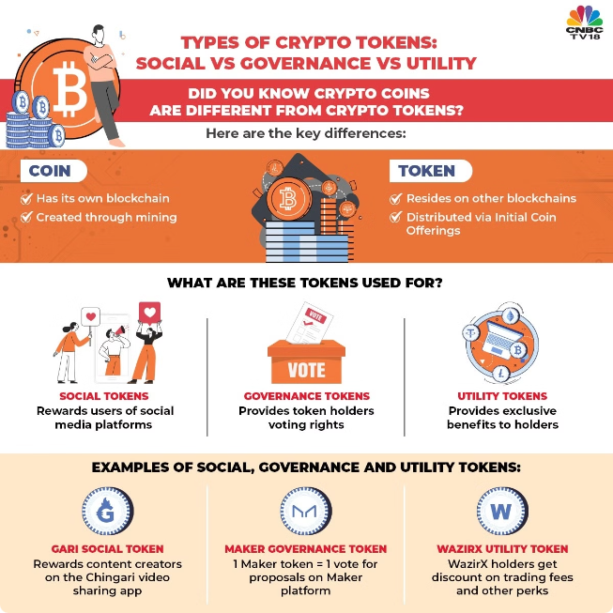
Fast Growing Token Type
HCE Tokens
Host Card Emulation (HCE) tokens are experiencing rapid growth in the mobile payments space.
Flexibility
HCE tokens are software-based, offering greater flexibility and ease of deployment compared to hardware-based solutions.
Adoption
Services like Google Pay and Samsung Pay that utilize HCE are becoming increasingly popular.

Slide 55
Future Token Types
Cloud-Based Tokens
The future of tokenization is leaning towards cloud-based tokens, offering enhanced security and seamless updates.
Cloud-Based Tokens
Incorporating biometric verification and AI-based fraud detection to further protect online transactions.
Interoperable Tokenization
Developing tokens that can be used seamlessly across different payment networks and platforms.

Slide 56
Token Fraud Risks
Provisioning Risks:
Inadequate controls:
If issuers do not set up proper controls for the token provisioning process, fraudsters can create tokens for lost or stolen cards.
Identity verification failures:
Weak or compromised identity verification processes during token provisioning can lead to unauthorized tokens being issued.
Post-Provisioning Risks:
Social engineering attacks: Fraudsters may use social engineering tactics, such as phishing or vishing, to trick users into revealing their token information.
Hacking merchant systems: Merchants' systems that store or process tokens can be targeted by hackers to steal token data.
Lost or stolen devices: Tokens stored on lost or stolen devices can be used by unauthorized individuals if additional security measures (e.g., biometric authentication) are not in place.
Man-in-the-middle attacks: Interception of token data during transmission can allow attackers to capture and misuse tokens.
Malware attacks: Malware on users’ devices can capture token information and send it to attackers.

Slide 57
Specific Token Fraud Risks In E-Commerce
Card-Not-Present (CNP) Fraud:
Fraudsters use stolen token data to make online purchases where the physical card is not required.
Examples: Using tokenized payment details on e-commerce websites for unauthorized transactions.
Account Takeover (ATO):
Fraudsters gain access to a user's e-commerce account, change the payment method to a stolen token,
and make purchases.
Examples: Compromising a user's login credentials through phishing and then using stored tokens to make fraudulent purchases.
Token Skimming:
Fraudsters use malicious software or devices to capture token information during online transactions.
Examples: Malware that intercepts token data when a user enters payment information on a compromised e-commerce site.
Replay Attacks:
Attackers intercept token transaction data and reuse it to make unauthorized purchases.
Examples: Reusing intercepted token data from a legitimate transaction to perform additional unauthorized transactions.
Cross-Site Scripting (XSS) Attacks:
Exploiting vulnerabilities in e-commerce websites to inject malicious scripts that capture token data.
Examples: Using XSS to steal token information entered by users on checkout pages.

Slide 58
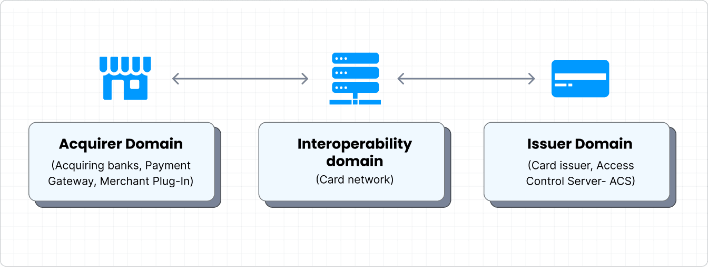
3D Secure Transactions
3D Secure add an extra layer to the online card transactions
3D Secure enhances security measures for merchants
When 3D Secure is enabled -> asked for validation of every transaction with PIN or Password
3DS stands for 3 Domains Secure. It facilitates authentication across three domains.
There are currently 2 types of 3DS – 3DS 1.0 and 3DS 2.0

Slide 59
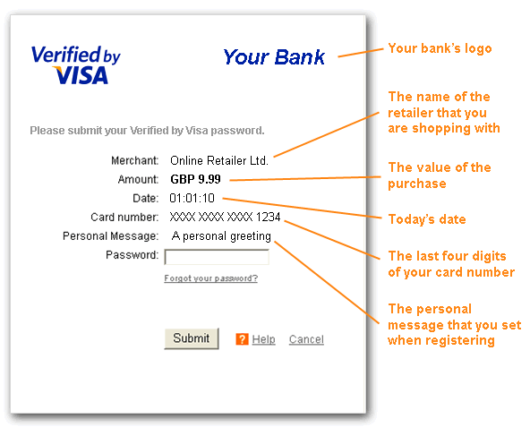
Overview of 3DS
3DS 1.0 developed in 1999 and it was first implemented in Visa as Verified by Visa (Visa Secure) in 2001.
How 3DS works?
Whenever you make online purchases, you enter your card details to confirm a payment, it redirected to another page where your bank asks for a code or password to authorize the transaction.
Why 3DS needed?
Despite having security measures like Address Verification System or CVC verification, credit / debit card payments remains prone to fraud.
It added extra layer of fraud protection by requesting static information like PIN or Password
Who decides the transactions as 3DS transactions ?
Merchant initiate or convert the normal transaction to 3DS
When merchant decides to step up a transaction with increase security by deploying 3D Secure then this protocol transfers more data points (IP address, device ID/Make, Click speed etc) to the issuer/network/merchant infrastructure allowing them to conduct
risk assessment while approving/authenticating the transaction.

Slide 60
3DS 1.0 vs 3DS 2.0
3DS 1.0
3DS 2.0
Customer Experience
It redirected to a separate authentication page,
in a more disruptive checkout experience.
3DS2 minimizes interruptions during the checkout process Only high-risk transactions require additional auth.
Mobile Integration
It was not optimized for mobile experiences
Built for mobile use, optimized for mobile integrations
Data Points
Used fewer data points during the authentication
process
Uses many more data points (such as transaction history,
device info, OTP, Biometrics) for a risk-based assessment
Frictionless Flow
Required a password or some form of static authentication from the cardholder.
It is frictionless flow, where transactions can be
authenticated without the need for cardholder interaction.
Scope of Transaction
Mainly focused on card-not-present transaction
Broader in scope and covers more transaction types,
including mobile payments and card-on-file transactions.
Regulation and Compliance
Pre-dated some of the modern online payment regulations.
Comply with the European Union's Revised Payment Services Directive (PSD2), its requirement for Strong Customer Authentication (SCA) for online transaction

Slide 61
Flow of 3DS Transactions
Frictionless Authentication?
Frictionless authentication is an automated identity verification approach centered on risk assessment
to facilitate access for legitimate users while minimizing the need for the user to provide personal information.
To eliminate the risky users by declining the transaction
How Does Frictionless Authentication Work?
The approval of a transaction depends on the 3D Secure protocol's evaluation of the transaction's risk factor.
The 3D Secure protocol employs a range of risk-based assessments to thoroughly analyze each transaction and decide
if additional authentication is necessary.
Risk-based assessments encompass factors like:
Customer status (new or existing)
Total transaction value
Device information
Transaction history
Behaviour history
Frictionless authentication
Transaction is authenticated without additional input from the customer.
Yes
Frictionless possible?
Can the transaction avail of frictionless authentication?
Yes
Challenge authentication
Customer prompted to authenticate payment with additional input (password or biometric).
3DS supported?
Is 3D Secure 2 supported for this transaction?
No
3DS1 supported?
Is 3D Secure 1 supported for this transaction?
Traditional authentication
Customer either prompted for input or automatically approved(risk-based authentication).
No
Yes

Slide 62
3D Secure Authentication: The good, the bad and
what it means for your fraud prevention
How online merchants use 3D Secure
Online merchants integrate 3D Secure into their checkout processes to add an extra layer of security to card transactions
3D Secure authentication by the numbers:
3% The portion of transaction in the US that are subject 3D secure reviews | 12% 10-year global compound annual growth rate of 3DS- generated revenue | 33% Growth in merchants globally using 3D secure in 2023 vs 2022 | 1 to 2 Average number of AI & ML fraud solutions used by merchants globally
What are the main changes in 3DS 2.0
3DS 2.0 provides much more data to the issuing bank than 3DS version 1. That increases the chance the bank can approve the transaction through a frictionless flow, rather than a challenge flow
The picture from where 3DS Secure is virtually mandated:
47% Reduction in fraud pressure since 3DS-based SCA was required in Europe | 82% Criminal fraud chargeback reduction since 3DS-based SCA- was required in Europe
What is the liability shift rule in 3D Secure 2?
In traditional card-not-present transactions, where the cardholder’s presence cannot be physically verified, merchants are liable for chargebacks resulting from fraud. But when orders are authenticated through 3D Secure, the fraud liability shifts from the merchant to the card issuer or issuing bank.
Online customer experience vs. friction with 3D Secure:
36% of UK consumers couldn’t complete an online transaction due to 3DS-powered SCA | 37% CUK consumers who said they’d quite shopping with a retailer after 1 or 2 bad checkout experience
Disadvantages of 3DS
While the new, improved version of 3DS is just that, the potential friction endured by consumers
Entering a password or receiving a one-time code, can lead to a higher rate of cart abandonment
3D Secure authorization comes with downsides:
66% Increase in 1st Party fraud chargebacks since 3DS powered SCA | 22% U.S card abandonment due to checkout being too long and complicated | 6x fraud rate on 3DS- protected orders in North America vs. all CNP transactions

Slide 63
ECI Indicator on 3D Secure Protocol
Electronic Commerce Indicator - value returned by a Directory Server indicating the outcome of a 3DS Authentication.
There is a difference in ECI Indicator of Visa, Amex and JCB versus Mastercard
The ECI level also determines who is liable for fraudulent transactions.
List of ECI Indicator
Card Type | ECI Indicator
Visa Secure | 05
Mastercard Identity Check | 02
American Express SafeKey 2.0 | 05
Card Type | ECI Indicator
Visa Secure | 06
Mastercard Identity Check | 01
American Express SafeKey 2.0 | 06
Authentication Successful:
The issuer has confirmed the identity of the cardholder
and validated the EMV 3DS
Authentication Attempted:
A merchant will get this message if the customer
is not enrolled in 3DS
Card Type | ECI Indicator
Visa Secure | 07
Mastercard Identity Check | 00
American Express SafeKey 2.0 | 07
Card Type | ECI Indicator
Visa Secure | 07
Mastercard Identity Check | 00
American Express SafeKey 2.0 | 07
Authentication Failed:
The issuer could not authenticate the cardholder. Reason could be
incorrect data entry, canceled auth page, or some other error.
Authentication Not Permitted:
The request could not be completed. Again, the reason could be
card type is excluded, or the ACS doesn’t recognize the request.

Slide 64
Key Metrics for Authentication
Authentication:
It is a process of verifying the identity of a user or system before allowing access to resources or completing a transaction. It ensures that the person or system requesting access is who they claim to be
Decline Rate:
the percentage of transactions that are rejected or declined during the authentication process. This metric helps in understanding how often authentication attempts fail compared to the total number of attempted transactions.
Decline Rate=( Total No. of Transactions Attempted / No. of Declined Transactions )×100
Decline Rate:
% Step-Up Transaction (3DS Share):
The percentage of transactions that require additional authentication steps during the 3D Secure process. This metric is important in understanding how often transactions are subjected to further verification beyond the initial authentication attempt.
% of Step-Up Transactions = ( Total No. of 3DS Transactions / No. of Step-Up Transactions ) × 100
% Step-Up Transaction (3DS Share):
3DS Disturb Rate :
The proportion of 3D Secure (3DS) transactions where the authentication process was successfully completed. This metric indicates how often 3DS authentication is successful and not disrupted or failed during the transaction process.
3DS Disturb Rate (%)=( Total No. of 3DS Transactions / No. of 3DS Transactions with Successful Authentication )×100
3DS Disturb Rate
3DS Drop Rate :
The proportion of 3D Secure transactions that fail to complete due to issues or interruptions in the 3D Secure authentication process. This metric provides insight into the effectiveness and user experience of the 3D Secure system, specifically focusing on how often transactions are abandoned or disrupted because of authentication problems.
3DS Drop Rate (%)=( Total No. of 3DS Transactions / No. of 3DS Transactions Dropped )×100
3DS Drop Rate
% Suspected Fraud Declines :
The proportion of declined transactions that are rejected because they are suspected to be fraudulent. This metric indicates how often transactions are declined based on fraud detection mechanisms, whether implemented by the issuer (bank or card network) or the merchant’s system.
% Suspected Fraud Declines =( Total No. of Declined Transactions / No. of Declined Transactions Due to Fraud Suspicion )×100
% Suspected Fraud Declines

Slide 65
Key Metrics for Disputes
Disputes:
Disputes occur when there is a disagreement or conflict regarding the details, legitimacy or execution of a transaction.
Fraud Rate (reported in bps):
The proportion of the total sales amount that is attributed to fraudulent transactions. It is expressed in basis points (bps), where one basis point equals 0.01%. This metric provides insight into the relative scale of fraud compared to overall sales and is crucial for assessing the effectiveness of fraud prevention measures.
Fraud Rate (bps)=( Total Sales Amount / Total Fraud Amount )×10,000
Fraud Rate(reported in bps):
Chargeback Rate(reported in bps):
It measures the proportion of the total sales amount that is reversed due to chargebacks, expressed in basis points. This metric provides insight into the financial impact of chargebacks relative to overall sales, allowing for a precise assessment of chargeback frequency.
Chargeback Rate (bps)=( Total Sales Amount / Total Chargeback Amount) × 10,000
Chargeback Rate(reported in bps):
Fraud Liability Rate:
It measures the proportion of the total fraud amount that is attributed to chargebacks, expressed as a percentage. It provides insight into how much of the total fraud amount is being claimed back through chargebacks, reflecting the financial responsibility borne by the merchant versus the issuer or other parties.
Fraud Liability Rate (%)=( Total Fraud Amount / Total Fraud Chargebacks)×100
Fraud Liability Rate
Win Rate (Chargeback):
It quantifies the effectiveness of a merchant’s efforts to successfully dispute and reverse chargebacks. It is expressed as a percentage and indicates how many of the chargebacks initiated against a merchant are resolved in their favor.
Win Rate (Chargeback) (%)=( Total Number of Chargebacks / Number of Chargebacks Recovered )×100
Win Rate Chargeback
Second Escalation Rate:
Second Escalation Rate reflects the percentage of transactions that, after being disputed and reviewed initially, are further escalated for additional review or action. This often indicates that the initial resolution was unsatisfactory to either the customer or the issuer, prompting a further escalation of the dispute.
Second Escalation Rate (%)=( Total Number of Disputed Transactions/Number of Transactions with Second Escalation )×100
Second Escalation Rate

